Slide 1

Integrating technology to prevent aquatic invasive species in Minnesota
Innovations in Applied Data Symposium
3 June 2021
AIS Explorer
Dr Petra Muellner Director (Science & Data), Epi-interactive
Aotearoa’s Full-Service RStudio partner

Slide 2
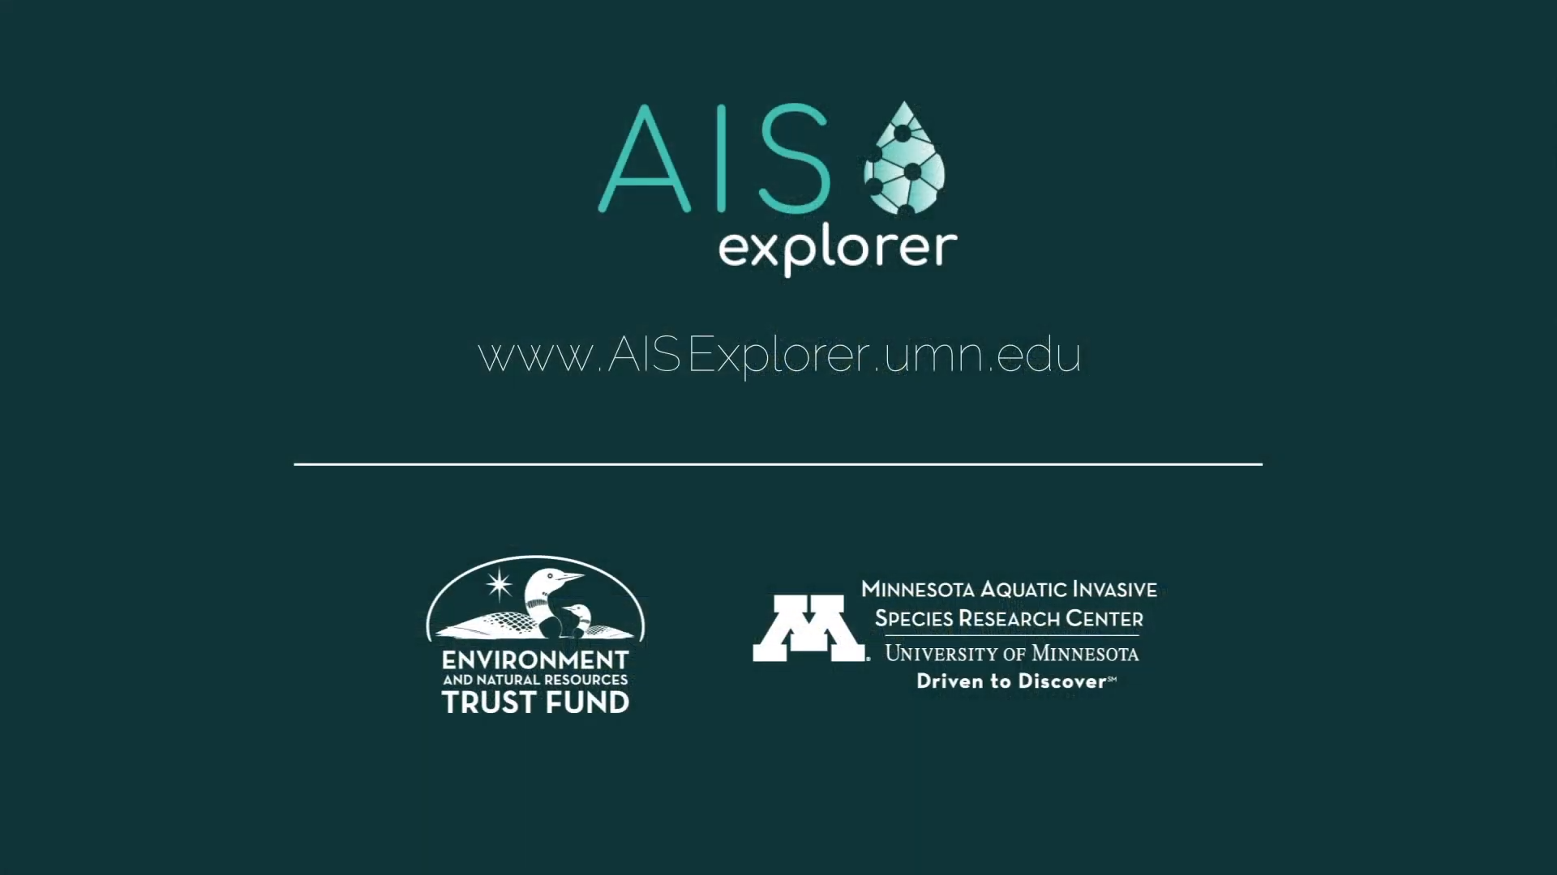
The challenge
Minnesota is well known for its beautiful “10,000 lakes” spread across 87 counties.
However, the complex system of waterbodies is threatened by the spread of aquatic invasive species.
Complex risk models are available that estimate infestation status and provide decision support.
Click here for video
What we did
We build an R Shiny app called the AIS Explorer which integrates complex analytics into an easy-to-use interface.
App has two modules:
Introduction Risk for Surveillance: Predicts infection risk by 2025 and displays lake connectivity
Prioritization for Watercraft Inspections: Suggests optimum placement of inspectors in a given county to maximise coverage of boater movements.
Applications updates are automated through a data pipeline that links with Minnesota’s Department of Natural Resources (DNR) infested waters list (1x weekly in peak session).

Slide 3
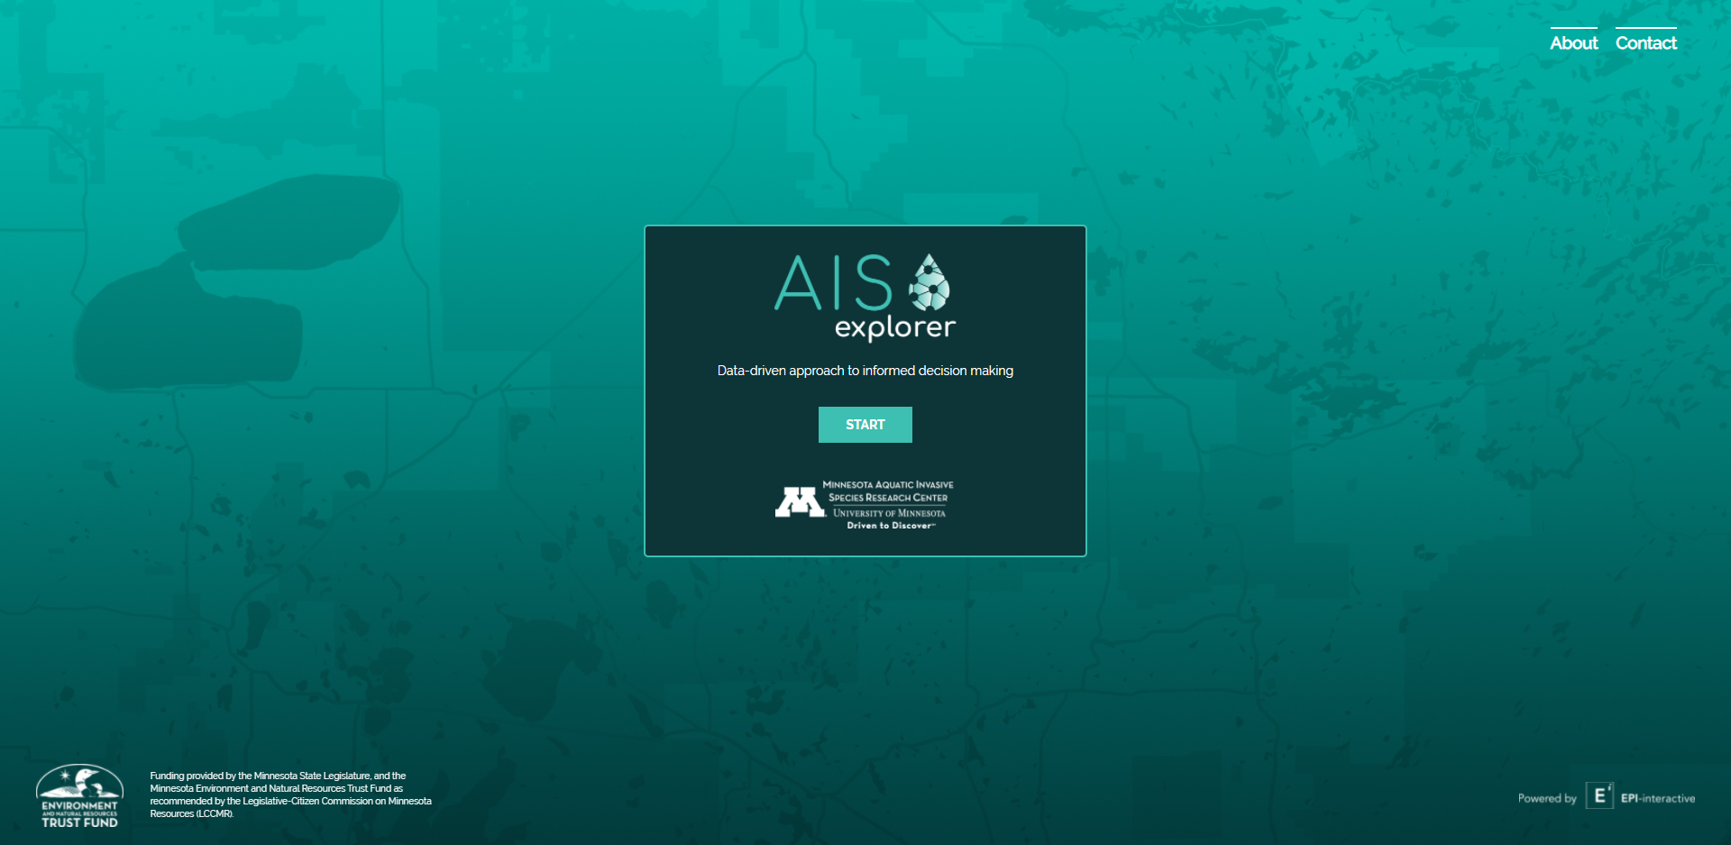

Access the dashboard at www.aisexplorer.umn.edu

Slide 4




Conclusions
By combining AWS, Python and R, the AIS explorer bridges the gap between complex research models and operational decision-support.
Layering allows user to easily explore specific lakes and their risk and connections (there are >10 million edges between lakes.
Applied development in collaboration with stakeholders was very important; project has just received new funding to continue to 2024.
Access the dashboard at www.aisexplorer.umn.edu
Contact for questions:
Dr Petra Muellner
petra@epi-interactive.com | www.epi-interactive.com
Thanks to the Minnesota Aquatic Invasive Species Research Center for this collaboration, specifically Prof. Nick Phelps and Dr. Amy Kinsley.
Aotearoa’s Full-Service RStudio partner

